Slide 1

Class of 2025
Course Selection
Mrs. Wall
hwall@pasco.k12.fl.us
Ms. Garcia
kgarcia@pasco.k12.fl.us

Slide 2
Overview
Graduation Requirements
  Courses & Credits
  GPA
  Testing
Course Selection

Slide 3
Academic worksheet
Every Student will receive one worksheet twice a year
If something is highlighted then they are either off track or missing their PE or Fine art req
  PE or Fine art should be fulfilled before senior year preferably by 11th grade
Gives each student a snap shot of where they stand for graduation

Slide 4
Graduation Requirements
Credits
GPA
Tests
Online Course

Slide 5
Credits
24 CREDITS TO GRADUATE HIGH SCHOOL!
  4 Math, 4 English, 3 Science, 3 Social Studies, 8 Choice Electives
  1 HOPE, 1 Fine Art, and 1 online course
Credits Received at Semester
  JANUARY (Semester 1)
  JUNE (Semester 2)
How are credits calculated???
  6 classes x .5 credit per class each semester=3 credits per semester
  3 credits per semester x 2 semesters per year=6 credits per year
  6 credits per year x 4 years=24 Credits
YOU NO LONGER REPEAT GRADES, YOU RECOVER LOST CREDITS

Slide 6
Testing/Assessments
MUST PASS:
Algebra 1 EOC
10th Grade Reading ELA
MUST SIT FOR:
Algebra 1 EOC
Biology EOC
Geometry EOC
US History EOC

Slide 7
AP vs. DE vs. Honors
Earn College credit [AP & Dual Enrollment]
GPA Weighted Differently
  Honors=.5
  AP & DE=1.0
AP vs. Dual Enrollment
  AP=Nationally Recognized
    College credit earned IF AP Exam is passed.
  Dual Enrollment
    College credit earned if DE course is passed
    College Credits Eligible FOR SURE within Florida State University System
    May or May not be Transferrable to Out of State Institutions

Slide 8
Dual Enrollment
  Qualifications
    Unweighted 3.0 GPA
    Pass PERT in reading, writing, and attempt math
      Must pass math to take more than 12 credit hours of DE
  Testing
    PERT offered week after Spring Break @LOLHS
      Deadline to sign up 2/28/22
    Sign up in Student services
    Can also take at PHSC. Go to phsc.edu for more info
  Considerations
    DE starts college GPA
    Taking a class at PHSC or online must leave campus
    Must maintain 2.0 GPA for DE courses
    Less parent involvement and grades will not show on My Student until the end of the semester

Slide 9
Course Selection

Slide 10
English Progression
9th Grade English 1 or Honors D or F
9th-English 1 or Honors C or Above
9th-English 1 or Honors A or B
10th-English 2 Honors/ AICE English
10th-English 2
10th-English 2 or English 2 Honors
11th-English 3
11th-English 3 or English 3 Honors
11th-AP Language or Dual Enrollment English
12th-English 4: College Readiness
12th-English 4 or English 4 Honors
12th-AP Literature or Dual Enrollment Elective

Slide 11
Math Progression
9th Grade Algebra 1 or Honors D or F
9th Grade-Algebra 1 or Honors C
9th Grade-Algebra 1 or Honors
A, B, or C Average
10th-Geometry
10th-Geometry
10th-Geometry Honors
11th-Math for Liberal Arts, Math for college statistics
11th-Algebra 2
11th-Algebra 2 Honors

Slide 12
Math Progression
9th Grade-Geometry Honors Failed EOC or class
9th Grade-Geometry Honors A or B Average
9th Grade-Algebra 2 Honors
10th- Math for Liberal arts OR Math for data financial Lit
10th-Algebra 2 Honors
10th- Pre-Calculus Honors
11th- Algebra 2, Math data financial Lit, Prob & Stat Hon
11th- Prob/Stat Honors, Pre-Calculus
11th-AP Statistics, AP Calculus, DE College Algebra

Slide 13
Science Progression
9th Grade-Earth Space Science
9th Grade-Biology or Honors D or F
9th Grade-Biology or Honors A, B, or C Average
10th-Biology
10th-Marine Science, Chemistry
10th-Genetics Honors, Marine Science or Honors, Chemistry or Honors, Physics Honors
11th- Environmental Science, Marine Science, Chemistry
11th-Environmental Science, Marine Science, Forensic Science,
11th-Anatomy & Physiology or Honors, Chemistry
Notes:
Genetics higher level reading
We study how organisms become who/what they are through analyzing molecular genetics (DNA, RNA, & proteins), inheritance patterns, and evolution. We apply our understanding through biotechnology and explore its uses in fields such as health, medicine, agriculture, and technology
Physics- The physics curriculum includes interactions of matter and energy, velocity, accelerations, force, energy, momentum and charge.

Slide 14
Social Studies Progression
9th Grade-No Social Studies
9th Grade-World History Honors
9th Grade-AP Human Geography
10th-World History or World History Honors
10th-AP Human Geography
10th-AP World History
11th-US History or US History Honors
11th-US History Honors or AP US History
11th-AP US History
12th-US Gov’t/Econ or US Gov’t Honors/Econ Honors
12th-US Gov’t/Econ Honors or AP US Gov’t/AP Macro Econ or DE Gov and Econ
12th-AP US Gov’t/AP MacroEcon or DE Gov and

Slide 15
Required Electives
Physical Education (1 Credit)
Fine Art (1 Credit)
1 Online Course (Semester or Full Year)
HOPE
Band
Digital Info Tech
Personal Fitness (online) + PE Elective
Chorus
Digital Design
Dance
HOPE [@LOLHS]
Personal Fitness (online) + 1 year of Marching Band
Acting
Any online course offered on Pasco eSchool or FLVS
2D Art 1
2 years of High School Sports
3D Art 1
Journalism 1

Slide 16
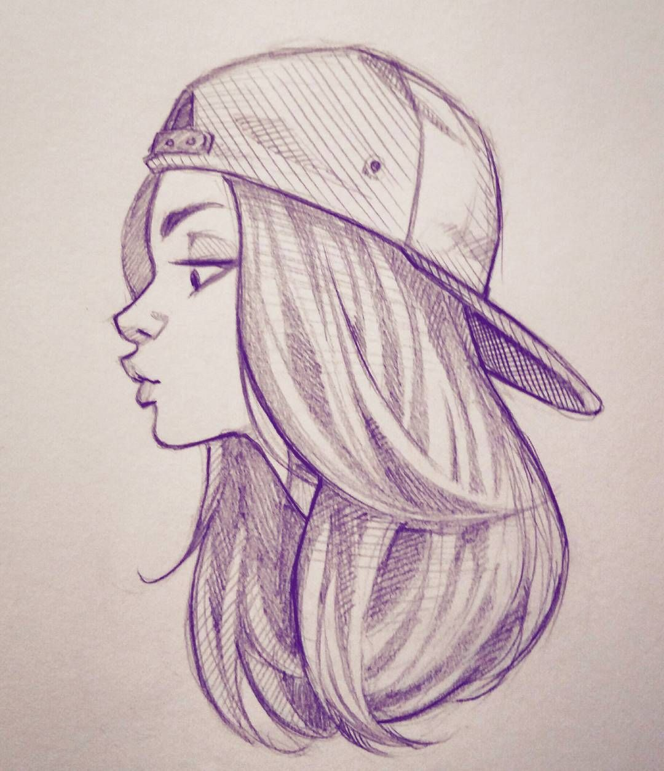


Art Progression
9th Grade
10th Grade
11th & 12th Grade
2D Art 1
2D Art 1
Portfolio Dev Honors
2D Art 2
AP Art
3D Art 1
AP Studio

Slide 17
PE Electives
Team Sports 1 (Semester )
Weight Training 1
(Semester)
Team Sports 2 (Semester)
Weight Training 2
(Semester)
Recreation (Semester)
HOPE
Basketball (Semester)

Slide 18



Academic Electives
Social Sciences
Social Studies
Electives
Specialty Electives
Contemporary History (Semester)
Creative Writing 1 & 2 (Semester)
Sociology (Semester)
Holocaust History Honors (Semester)
Psychology 1 & 2
Journalism 2:
TV Production or Yearbook
Law Studies (Semester)
AP Psychology
World Cultural Geography
AP Computer Science Principles
AP Human Geography
Notes:
World Cultural Geography looks at how we as humans interact with the earth and each other. It focuses on how we read demographic data such as maps to see how we can understand the world better. The course helps the student to learn about new places and cultures. The course makes ample use of videos “to take students” around the world. The goal is to learn how to think like a geographer!
Contemporary History is an in depth study into the events of the 50s-today. We look at major world events that are political, religious, cultural and social. Included in this is fashion, fads, music, tv, life as a woman and a teen.
Holocaust- The primary content emphasis for this course focuses on the causes, and actions of the Nazi regime during the Holocaust (1933-1945), the systematic, planned annihilation of European Jews and other groups by Nazi Germany.
Creative Writing- Students explore the different genres of writing and progress through the writing process. Students are able to express their thoughts in a variety of different avenues.

Slide 19
World Languages
Spanish
French
American Sign Language
Spanish 1
French 1
ASL 1
Spanish 2
French 2
ASL 2
French 3
ASL 3
Spanish 3 Honors
ASL 4 Honors
AP French
AP Spanish

Slide 20

Academy & Career Technical Education
Career Technical Education
Culinary Academy
Business Entrepreneurship Principles (H)
Digital Info Tech (FA)
9th Grade-
Nutrition & Food Science
Accounting (H), Management, Business Analysis
10th Grade-Culinary Arts 1
11th Grade-Culinary Arts 2
Technical Design (H)
12th Grade-Culinary Arts 3 & 4
Digital Design (FA) (H)
Early Childhood

Slide 21




Career Technical Education
Technical Design
Early Childhood
Digital Design
Business & Entrepreneurship
Digital Info Tech
Early Childhood 1
Digital Info Tech
Digital Info Tech/BEP
Technical Design 1
Early Childhood 2
Digital Design 1
Accounting 1
Technical Design 2
Management & HR
Early Childhood 3
Digital Design 2
Early Childhood 4
Business Analysis
Technical Design 3
Digital Design 3

Slide 22
Final Check
6 PRIMARY courses
4 core courses
  1 English class
  1 Mathematics class
  1 Science class
  1 Social Studies class
2 Elective Courses
  HOPE (if you are not taking it right now)
  Fine Art of your choice (if you are not taking it right now)
  If you are taking both of these right now, choose 2 electives
3 Backup Electives
  Number these 2, 3, 4, in order of priority
  Any changes to your requests are due by 3/12. They will be locked after that

Slide 23
Questions?
Join REMIND!
Text 81010 with a message of @lolhs20252 OR @lolhs20253

