Slide 1

Class of 2024
Course Selection
Mr. Moody
cmoody@pasco.k12.fl.us
(813) 794-9417
Twitter: @LOLHS2024
Remind: @lolhs20241
@lolhs20242
@lolhs20243
@lolhs20244
@lolhs20245

Slide 2
Overview
Graduation Requirements
  Courses & Credits
  On/Off Track
  GPA
  Testing
Course Selection

Slide 3
Graduation Requirements
Credits
GPA
Tests
Online Course

Slide 4
Credits
24 CREDITS TO GRADUATE HIGH SCHOOL!
  4 Math, 4 English, 3 Science, 3 Social Studies, 8 Choice Electives
  1 HOPE & 1 Fine Art
Credits Received at Semester
  JANUARY (Semester 1)
  JUNE (Semester 2)
How are credits calculated???
  6 classes x .5 credit per class each semester=3 credits per semester
  3 credits per semester x 2 semesters per year=6 credits per year
  6 credits per year x 4 years=24 Credits
YOU NO LONGER REPEAT GRADES, YOU RECOVER LOST CREDITS

Slide 5
Credit Recovery
IF SEMESTER CREDIT IS LOST, HOW DO I MAKE IT UP?
Core Academic Classes vs. Electives
Core Class
  Earn a high enough grade in the other semester to blend for full year credit
  Recover the course & semester failed in Extended School Year Credit Recovery [Summer School]
  Retake the course & semester failed online via Pasco eSchool or Florida Virtual School
  10th-12th: Retake the course & semester failed in after school Adult Education program
  11th and 12th: Retake the course & semester failed in credit recovery elective course
Elective
  Replace the failed semester by passing any elective online via Pasco eSchool or Florida Virtual School

Slide 6
Credits
How many credits should you have at the end of your 9th grade year?
How many credits should you have after the first semester of your 10th grade year?
How many credits should you have after your 11th grade year?
How many credits should you have at the end of your 12th grade year?

Slide 7
On Track
All credits earned for your cohort’s graduation year
2.0+ Unweighted Cumulative GPA
Less than 10% unexcused/excused absences the previous quarter

Slide 8
At Risk or Off Track
Academics
  ½ -18 credits behind
  Less than a 2.0 cumulative GPA
Attendance
  Greater than 10% absences

Slide 9
Grade Point Average (GPA)
What is the minimum cumulative unweighted GPA you must have to graduate high school?
Calculating GPA & Quality Points
Grade | A | B | C | D | F
Quality Points | 4 | 3 | 2 | 1 | 0
Grade (Honors) | A | B | C | D | F
Quality Points | 4.5 | 3.5 | 2.5 | 1.5 | 0
Grade (AP or DE) | A | B | C | D | F
Quality Points | 5 | 4 | 3 | 2 | 0

Slide 10
Grade Point Average (GPA)
What is my current unweighted GPA????
A= x 4=
B= x 3=
C= x 2=
D= x 1=
F= x 0=
Add the second column. Total QPoints
GPA=Total QPoints divided by total number of classes
QPts / classes= GPA

Slide 11
AP vs. DE vs. Honors
Earn the same amount of high school credits per course [.5 per semester, 1.0 per year]
Earn College credit [AP & Dual Enrollment]
GPA Weighted Differently
  Honors=.5
  AP & DE=1.0
College Resume Builders
AP vs. Dual Enrollment
  AP=Nationally Recognized
    College credit earned IF AP Exam is passed.
  Dual Enrollment
    College credit earned if DE course is passed
    College Credits Eligible FOR SURE within Florida State University System
    May or May not be Transferrable to Out of State Institutions
    Talk to Mr. Moody for more information

Slide 12
Testing/Assessments
MUST PASS:
Algebra 1 EOC
10th Grade Reading ELA
MUST SIT FOR:
Algebra 1 EOC
Biology EOC
Geometry EOC
US History EOC

Slide 13
Course Selection
Log into myStudent
Click “Class Requests”
In upper right hand corner, change to 2021-2022 School Year

Slide 14
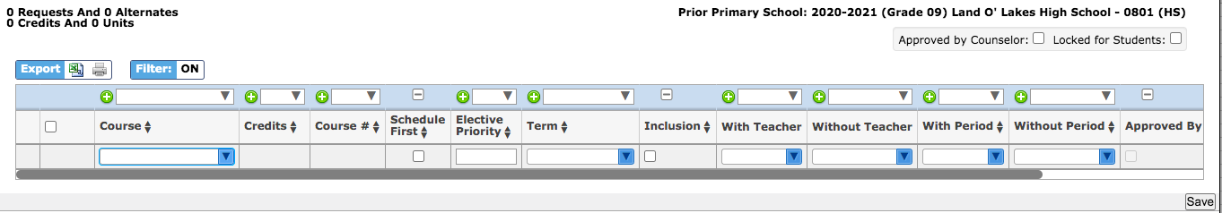
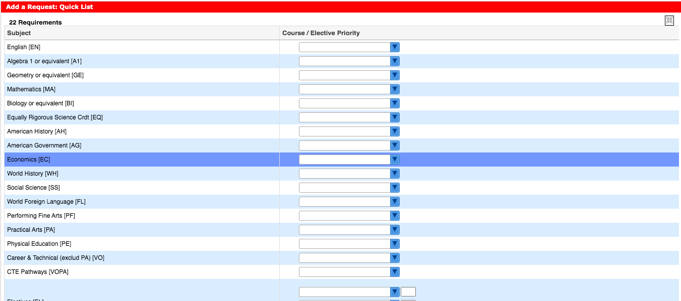
Course Selection

Slide 15
English Progression
9th Grade English 1 or Honors D or F
9th-English 1 or Honors C or Above
9th-English 1 or Honors A or B
10th-English 2
10th-English 2 or English 2 Honors
10th-English 2 Honors
11th-English 3
11th-English 3 or English 3 Honors
11th-AP Language or Dual Enrollment English
12th-English 4: College Readiness
12th-English 4 or English 4 Honors
12th-AP Literature or Dual Enrollment Elective

Slide 16
English Progression

Slide 17
Math Progression
9th Grade Algebra 1 or Honors D or F
9th Grade-Algebra 1 or Honors C
9th Grade-Algebra 1 or Honors
A, B, or C Average
10th-Lib Arts Math 1
10th-Geometry
10th-Geometry Honors
11th-Geometry
11th-Algebra 2
11th-Algebra 2 Honors
12th-Math for College Readiness
12th-Adv Math Topics, Prob/Stat Honors, Pre-Calculus
12th-Adv Math Topics, Prob/Stat Honors, Pre-Calculus

Slide 18
Math Progression
9th Grade-Geometry Honors C Average
9th Grade-Geometry Honors A or B Average
9th Grade-Algebra 2 Honors
10th-Algebra 2
10th-Algebra 2 Honors
10th-Adv Math Topics, Prob/Stat Honors, Pre-Calculus
11th-Adv Math Topics, Prob/Stat Honors, Pre-Calculus
11th-Adv Math Topics, Prob/Stat Honors, Pre-Calculus
11th-AP Statistics, AP Calculus, DE College Algebra
12th-AP Statistics or AP Calculus
12th-AP Statistics or AP Calculus
12th-AP Statistics, AP Calculus, DE Math

Slide 19
Math Progression

Slide 20
Science Progression
9th Grade-Environmental Science
9th Grade-Biology or Honors D or F
9th Grade-Biology or Honors A, B, or C Average
10th-Biology, Agriscience Foundations
10th-Agriscience Foundations, Earth/Space Science
10th-Genetics Honors, Marine Science or Honors, Chemistry or Honors
11th-Earth/Space Science, Agriscience Foundations, Marine Science
11th-Marine Science, Environmental Science, Agriscience Foundations, Earth Space Science
11th-Anatomy & Physiology or Honors
12th- Earth/Space Science, Agriscience Foundations, Marine Science
12th-Environmental Science, Earth/Space Science
12th-Chemistry or Honors, Physics Honors, AP Env Sci

Slide 21
Science Progression

Slide 22
Social Studies Progression
9th Grade-No Social Studies
9th Grade-World History Honors
9th Grade-AP Human Geography
10th-World History or World History Honors
10th-AP Human Geography
10th-AP World History
11th-US History or US History Honors
11th-US History Honors or AP US History
11th-AP US History
12th-US Gov’t/Econ or US Gov’t Honors/Econ Honors
12th-US Gov’t/Econ Honors or AP US Gov’t/AP MacroEcon
12th-AP US Gov’t/AP MacroEcon

Slide 23
Social Studies Progression

Slide 24
Required Electives
Physical Education (1 Credit)
Fine Art (1 Credit)
1 Online Course (Semester or Full Year)
HOPE
2D Art 1
Digital Info Tech
Personal Fitness (online) + PE Elective
Band
Digital Design
Chorus
HOPE [@LOLHS]
Personal Fitness (online) + 1 year of Marching Band
Dance
Any online course offered on Pasco eSchool or FLVS
Acting
Digital Info Tech
2 years of High School Sports

Slide 25



Art Progression
9th Grade
10th Grade
11th & 12th Grade
2D Art 1
2D Art 1
Portfolio Dev Honors
2D Art 2
AP Art
3D Art 1
AP Studio

Slide 26
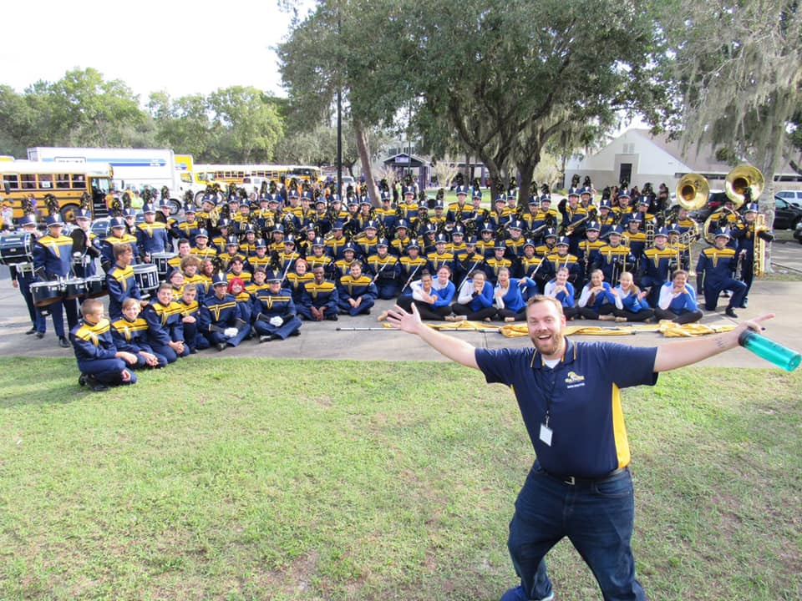
Band
Open to all students regardless of previous band experience
All band students are members of the marching band and concert bands, optional to join jazz or percussion band
Perform at football games, festivals, and school concerts/events throughout the year
Regularly travel throughout Florida, traveling to Washington DC in May

Slide 27
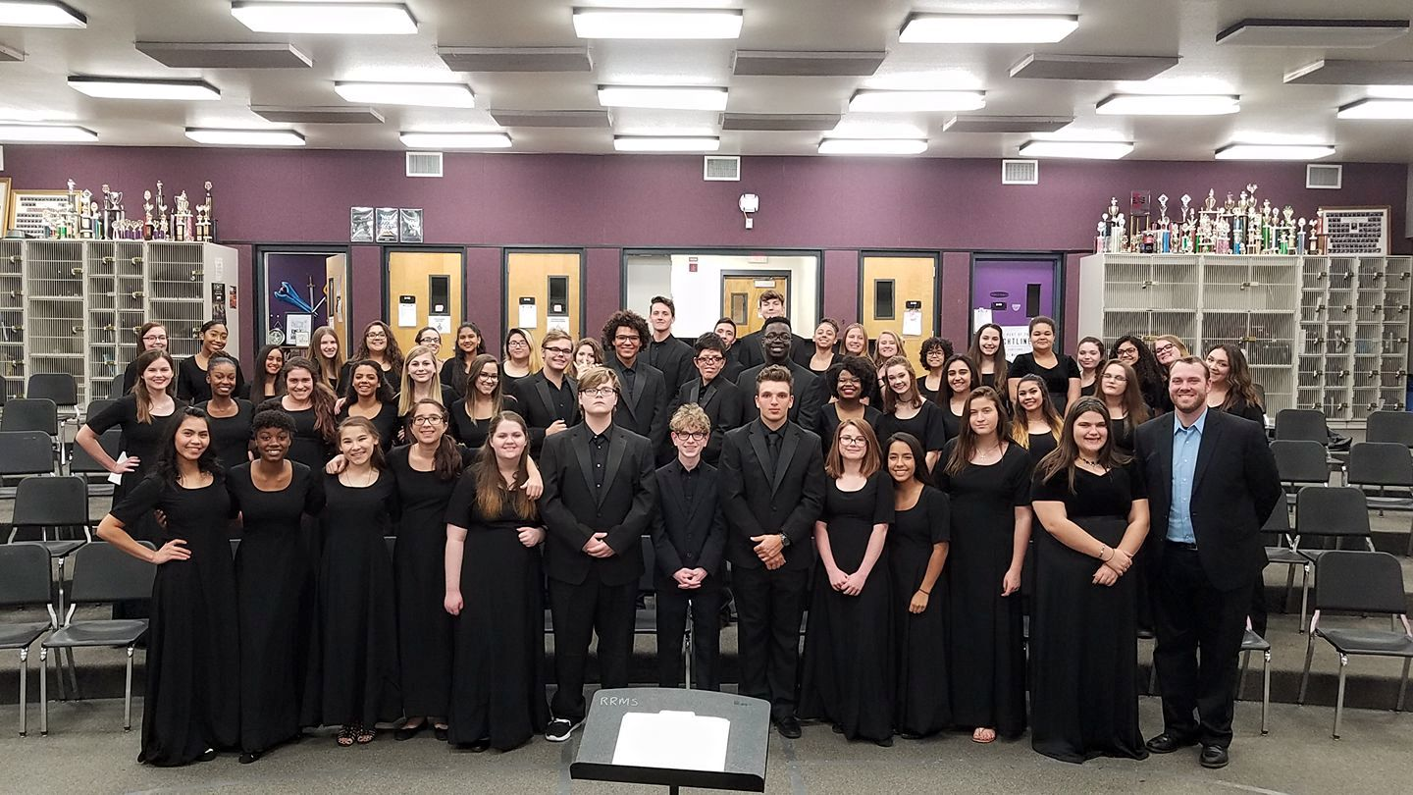
Chorus
Open to all students regardless of previous chorus experience
Perform regularly at festivals, school and community events

Slide 28

Dance Techniques
Cheer
  Competitive
  Sideline
Color & Winter Guard
  Perform with marching band in fall, opportunity to continue into spring with competitive team
  Incorporates dance and choreographed routines with equipment
  Great for students with dance background

Slide 29
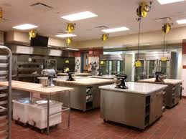
Academy & Career Technical Education
Culinary Academy
Career Technical Education
Technical Design
Early Childhood
9th Grade-
Nutrition & Food Science
Digital Design
Business Entrepreneurship Principles
10th Grade-Culinary Arts 1
11th Grade-Culinary Arts 2
Accounting, Management, Business Analysis
12th Grade-Culinary Arts 3 & 4

Slide 30




Career Technical Education
Technical Design
Early Childhood
Digital Design
Business & Entrepreneurship
Digital Info Tech
Early Childhood 1
Digital Info Tech
Digital Info Tech/BEP
Technical Design 1
Early Childhood 2
Digital Design 1
Accounting 1
Technical Design 2
Management & HR
Early Childhood 3
Digital Design 2
Early Childhood 4
Business Analysis
Technical Design 3
Digital Design 3

Slide 31
World Languages
Spanish
French
American Sign Language
Spanish 1
French 1
ASL 1
Spanish 2
French 2
ASL 2
French 3
ASL 3
Spanish 3 Honors
ASL 4 Honors
AP French
AP Spanish

Slide 32



Academic Electives
Social Sciences
Social Studies
Electives
Specialty Electives
Contemporary History (Semester)
Creative Writing 1 & 2 (Semester)
Sociology (Semester)
Holocaust History Honors (Semester)
Psychology 1 & 2
Journalism 2:
TV Production or Yearbook
World Cultural Geography
AP Psychology
AP Human Geography
AP Computer Science Principles

Slide 33
Final Check
6 PRIMARY courses
4 core courses
  1 English class
  1 Mathematics class
  1 Science class
  1 Social Studies class
2 Elective Courses
  HOPE (if you are not taking it right now)
  Fine Art of your choice (if you are not taking it right now)
  If you are taking both of these right now, choose 2 electives
3 Backup Electives
  Number these 2, 3, 4, in order of priority
  Any changes to your requests are due by 3/12. They will be locked after that

Slide 34
Questions?

