Slide 1
Class of 2024
9th Grade Course Selection
Administration
Mr. Mellin- Principal
Mrs. Beerman-Assistant Principal
Student Services
Mr. Moody-School Counselor
Ms. Campbell-Graduation Coach
Ms. Colon-College/Career Specialist

Slide 2
Today’s Purpose
Know:
Course Requirements, Elective Requirements, and Academy and Elective Opportunities
Understand:
Learn all of the credit, GPA, and testing requirements you need to graduate from high school
Do:
Choose 3 required core courses
Choose 2 required elective courses
Choose 1 choice elective class

Slide 3
Graduation Requirements

Slide 4
Graduation Requirements
Credits=24
1 Online Course
State Tests=Algebra 1 EOC & 10th Grade Reading
Cumulative Unweighted GPA=2.0 or higher
  Calculated at Semesters Only!
  Semester 1 = Quarter 1% + Quarter 2% (January after Christmas Break)
  Semester 2 = Quarter 3 % + Quarter 4 % = (June after school is over)
    Quality Points
      A=4, B=3, C=2, D=1, F=0
      Honors = +0.5
      Dual Enrollment/AP = +1.0
      Unweighted vs. Weighted

Slide 5
Graduation Requirements

Slide 6
English Pathways (4 Credits)
8th Language Arts ELA Level 1,2 or 3
9th English 1
8th Language Arts Adv ELA Level 4 or 5
10th English II
11th English III
12th English IV
9th English 1 Honors
10th English II Honors
11th English III Honors
12th English IV Honors
9th English 1 Honors
10th English II Honors
AP Language or Dual Enrollment 1101/1102
AP Literature or Dual Enrollment elective
8th Language Arts Adv ELA Level 3, 4 or 5

Slide 7
Math Pathways (4 Credits)
10th Algebra II Honors
11th Advanced Math Topics, Prob & Stat Honors, or Pre-Calculus
8th Geometry Honors
10th Advanced Math Topics, Prob & Stat Honors, or Pre-Calculus
12th AP Statistics or AP Calculus
10th Liberal Arts I
11th Geometry
12th Math for College Readiness
9th Geometry Honors
9th Algebra II Honors
11th AP Statistics or AP Calculus
8th Mathematics- level 4 or 5 on FSA Math
9th Algebra 1 Honors
10th Geometry Honors
11th Algebra II or Algebra II Honors
8th Algebra 1 Honors
12th Advanced Math Topics, Prob & Stat Honors, Pre-Calculus
12^{th-}AP Calculus or AP Statistics
9th Algebra 1
8th Mathematics with level 1, 2 or 3 on FSA Math

Slide 8
Science Pathways (3 Credits)
8th Grade Science FSA ELA 1 or 2
9^{th-}Biology
9^{th -}Environmental
10^{th-}Biology
8th Grade Science/Advanced Science FSA ELA 3
8th Grade Science/Advanced Science FSA ELA 3, 4 or 5 and A or B in current science
11^{th/}12^{th-}Marine Science, Physical Science, or Anatomy & Physiology
10^{th-}Marine Science, Environmental Science, or Physical Science
11^{th /}12^{th-}Marine Science, Physical Science, or Anatomy and Physiology
9th-Biology Honors
10th-Chemistry Honors
11th-AP, Dual Enrollment or Honors Science course
12th-AP, Dual Enrollment or Honors Science course

Slide 9
Choose Fine Art requirement
Fine Art
Fine Art Equivalent
2-D Studio Art 1
Band
Chorus
Acting 1
Dance Techniques
Digital Information Technology (meets online requirement also)
Journalism 1
Technical Design
Notes:
We will go into detail about each elective

Slide 10
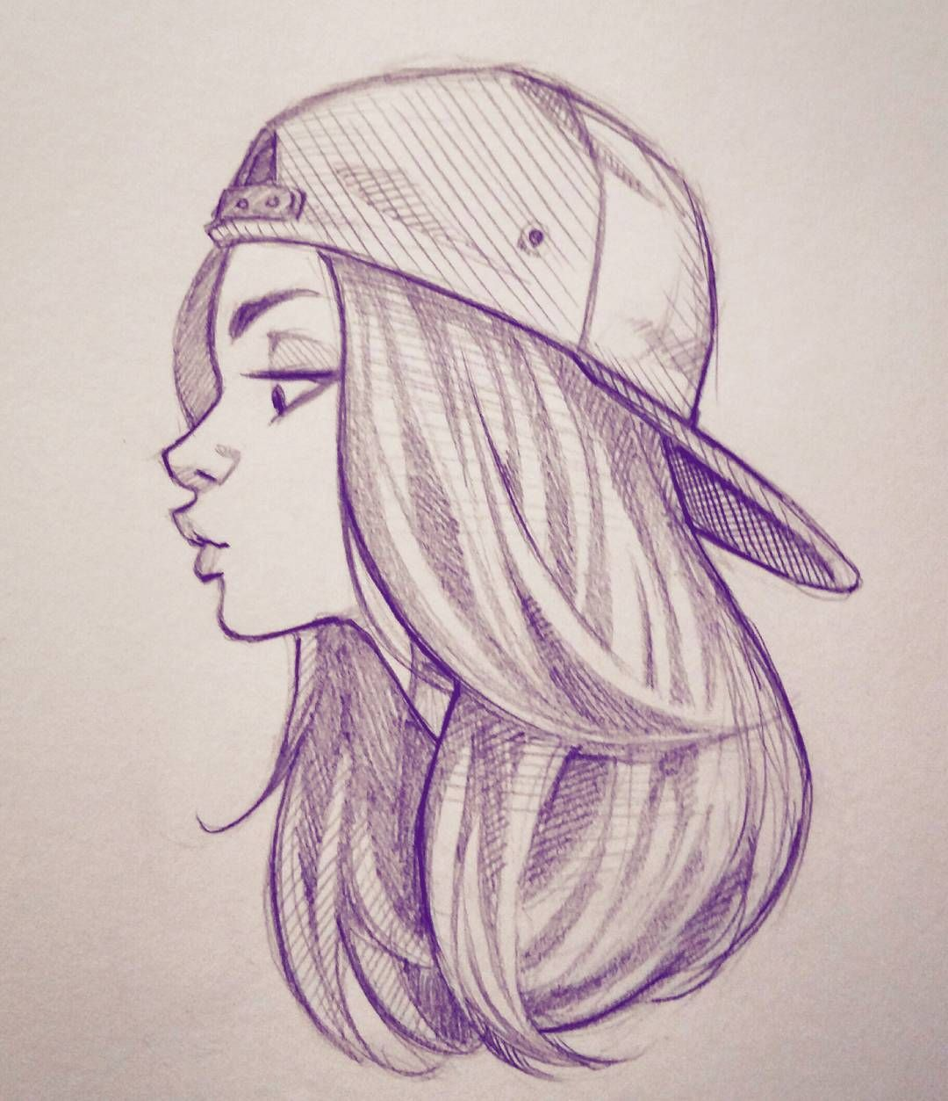


Art
9th Grade
2-D Studio Art 2
Portfolio 1,2 and 3
AP 2D Design or AP Drawing
2-D Studio Art 1
10th Grade
11th/12th Grade

Slide 11
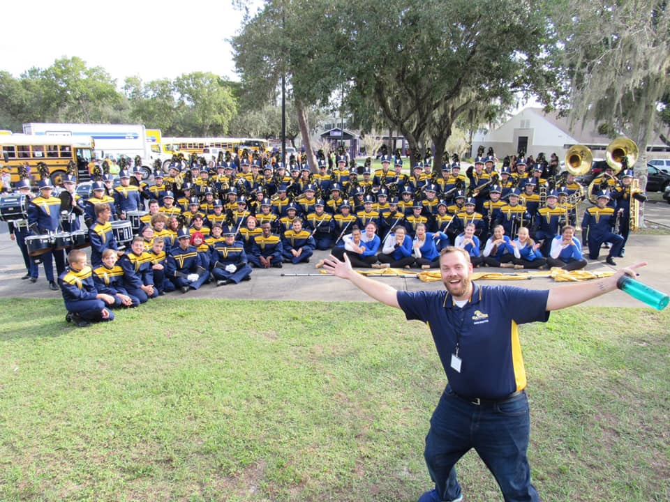
Band
After School Component
Open to all students regardless of previous band experience
All band students are members of the marching band and concert bands, optional to join jazz band
Perform at football games, festivals, and school concerts/events throughout the year
Regularly travel throughout Florida, traveling to Washington DC in May
Notes:
Intense after school commitment

Slide 12
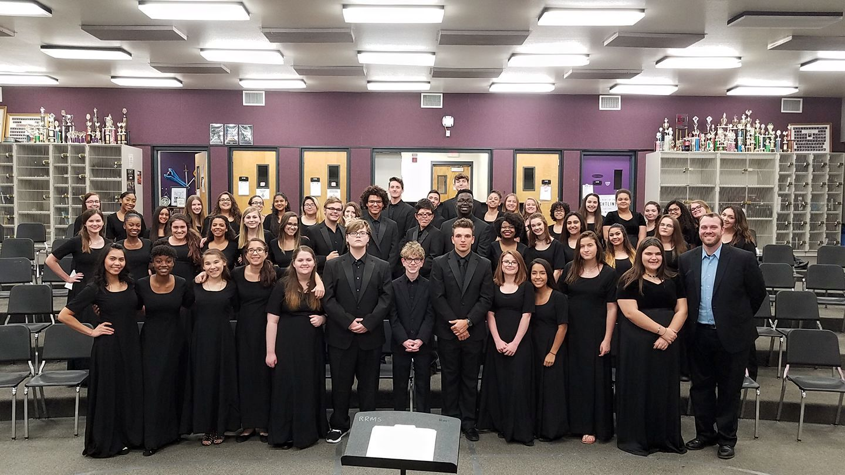
Chorus
Open to all students regardless of previous chorus experience
Perform regularly at festivals, school and community events

Slide 13


Acting

Slide 14

Dance Techniques
Cheer
  Competitive
  Sideline
Color & Winter guard
  Perform with marching band in fall, opportunity to continue into spring with competitive team
  Incorporates dance and choreographed routines with equipment
  Great for students with dance background

Slide 15

Journalism
Notes:
NEW PICTURE Writing Articles, Newspaper, Yearbook

Slide 16



Digital Information Technology
A path to your success
in school and work
Fine Arts Credit
Online Credit

Slide 17


Physical Education Requirement
At LOLHS During School
Online
Online
Personal Fitness [Online] +
  Online=Outdoor Education or Fitness Lifestyle Design
  At LOLHS=Recreation, Basketball, Team Sports I/II
  2 years of Marching Band
HOPE online over summer
  Need MS Counselor Approval
HOPE- currently meets online requirement.

Slide 18
Course Cards
Students MUST select each of the following
  1 English class
  1 Mathematics class
  1 Science class
  1 Fine Art
  1 HOPE option
  _________________________
  Total 5 classes

Slide 19
Required Electives
Physical Education
Online
HOPE (also meets online requirement)
Any course offered on Pasco or Florida Virtual
Fine or Performing Art
Band
Chorus
Acting 1
Dance Techniques
2-D Studio Art 1
Journalism 1
Digital Info Tech
Computer Science, DIT, Technical Design all satisfy this requirement
Technical Design
Notes:
Students will automatically be placed in a HOPE class their 9th grade year unless they have completed the course prior to the beginning of the 2016/17 school year

Slide 20
Academic Electives
Academy
Culinary
Agriculture
Technical Design
Career Technical Education
Early Childhood

Slide 21
Academic Electives
World Languages
Spanish
French
Academic Electives
World History Honors**
American Sign Language
Creative Writing I/II
AP Human Geography**
AP World History**
AP Computer Science Principles**
Notes:
*Meets Social Studies course requirement
**

Slide 22
Academies
Culinary
Culinary 2
Agriscience Technology
Agriscience Foundations
Biotech 2
Culinary 4
Biotech 3
Culinary 3
Animal/Plant Biotech
Food Science, Safety, Tech

Slide 23
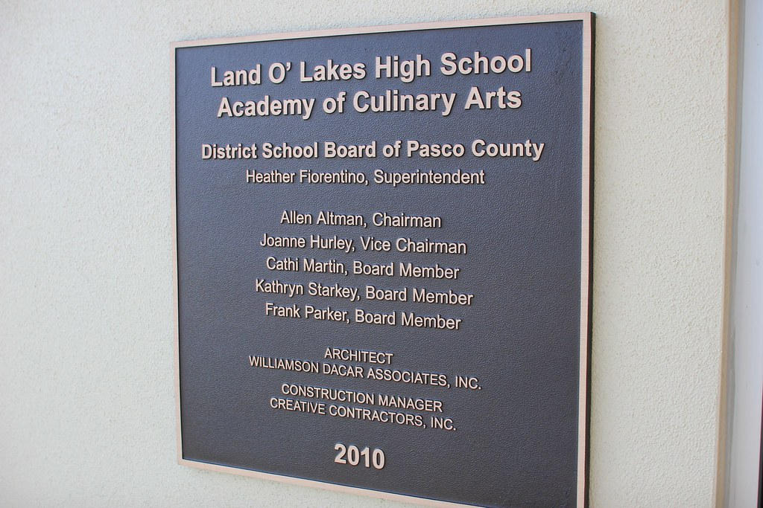
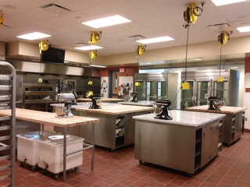
Culinary

Slide 24
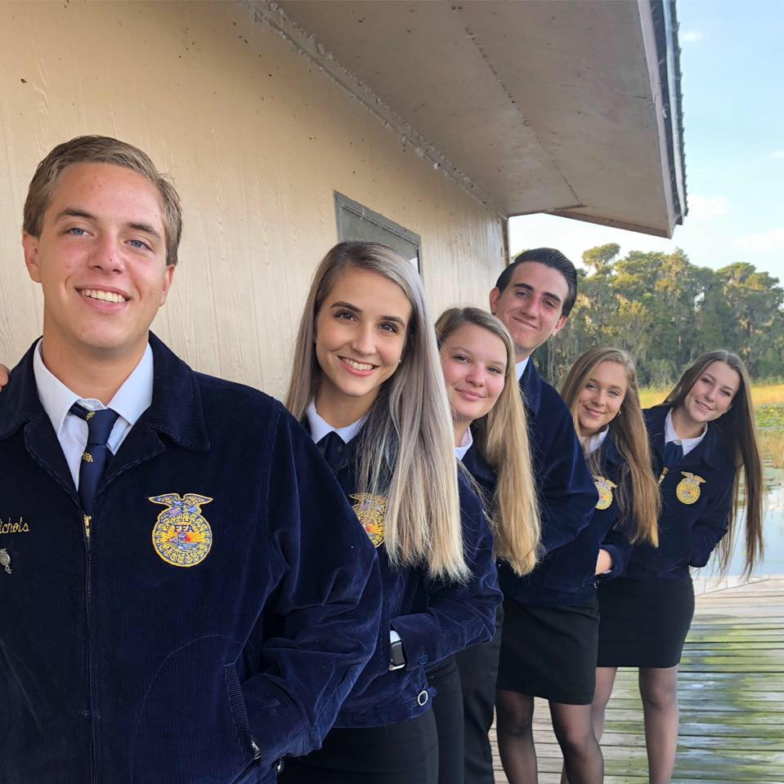
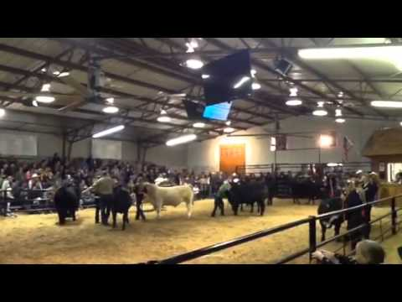
Agriculture
Participate in Pasco County Fair
Work with Steers & other farm animals in on-campus Barn
FFA Leadership Opportunities

Slide 25
Career Technical Education
Technical Design
Technical Design 1
Early Childhood
Early Childhood 1
Early Childhood 2
Technical Design 3
Early Childhood 3
Technical Design 2
Early Childhood 4
Digital Information Technology
Digital Design
Digital Information Technology
Digital Design 1
Digital Design 2
Digital Design 3

Slide 26



Digital Design
Fine Arts Credit
Online Credit

Slide 27
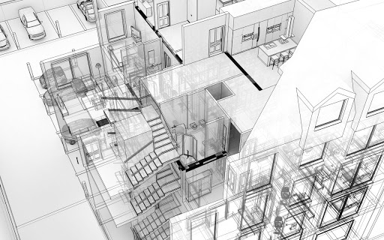
Technical Design
TECHNICAL DESIGN I SERVES AS AN INTRODUCTION TO THE BASIC CONCEPTS OF ENGINEERING AND ARCHITECTURAL DESIGN AND
NAVIGATING THE CAD, COMPUTER AIDED DRAWING PLATFORM.
Fine Arts Credit
Online Credit
A three course program leading to industry certification
CAD, or computer-aided design and drafting (CAD), is the use of computer technology for design and design documentation. CAD software replaces manual drafting with an automated process.

Slide 28
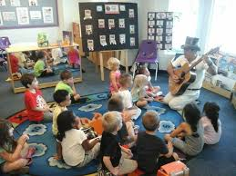
Early Childhood

Slide 29
Social Studies Pathways (3 Credits)
8th Grade US History
9th AP Human Geography or AP World History
10th AP World History
11th AP US History
12th AP Government and AP Macro Economics
9th World History Honors
10th A.P. Human Geography (elective)
11th AP U.S. History
12th AP Government AP Macro Economics
8th Adv U.S History
9th No required course
11th US History or US History Honors
12th Econ/Gov or Econ/Gov Honors
8th Adv U.S History
10th World History or World History Honors
Notes:
Emotional/Controversy
Level 1 or 2 No Social Studies
Level 3 in advanced

Slide 30


AP Computer Science Principles
Students learn a foundation to understanding how computer science relates to every day life.
NOT a programming class.
Does expose students to the process of how to build interactive applications using a fun “block based” programming tool
NOT a coding language.

Slide 31
Final Check
You should have selected
  1 English class
  1 Mathematics class
  1 Science class
  1 HOPE
  1 Fine Art (Optional)
  1 Additional Elective
  _________________________
  Total 6 classes
  *Made 3 backup choices
  *Prioritized 1-3
  **Final schedule changes must be turned in by Friday, February 14, 2020
Notes:
Emphasis

Slide 32

Athletics
Fall
  Cross Country
  Cheerleading
  Football
  Golf
  Swimming & Diving
  Volleyball
Winter
  Girls & Boys Basketball
  Hockey
  Girls & Boys Soccer
  Girls Weight Lifting
  Wrestling
Spring
  Baseball
  Softball
  Tennis
  Track & Field
  Boys Weight Lifting
Mr. Frump
Athletic Director
Room 539
Notes:
Emphasis

Slide 33
Gator Rewards & Privilege Bands
LOLHS rewards positive academic and behavioral success by providing students with earned privileges based on their ATTENDANCE, BEHAVIOR, & GRADES (GPA AND CREDITS).
Students will receive levels of privileges based on their ON/OFF TRACK status. Privileges may include free or discounted tickets to school events such as sporting events, dances and monthly reward celebrations.

Slide 34
On/Off Track Status
Highly On Track On Track
3.5 or Higher GPA 2.0-3.4 GPA
0 Discipline Referrals 0 Discipline Referrals
All credits All credits
30 or less absent periods/quarter 30 or less absent periods/quarter
At Risk for Off Track-Any one or more of these Off Track
Less than a 2.0 GPA Less than a 2.0 GPA
1 or More Discipline Referrals 1 or more Discipline Referrals
Behind by no more than ½ credit Behind 1-3 credits
Greater than 30 absent periods/quarter Greater than 30 absent periods/quarter
Highly Off Track
Less than a 2.0 GPA
1 or more Discipline Referrals
Behind more than 3 credits
Greater than 30 absent periods/quarter

Slide 35
Loss of Privileges
Students that are off track are excluded from reward incentives and may not participate in extracurricular activities. These include but are not limited to dances (Homecoming and Prom), special events, club activities, field trips, grade-level activities and athletics. This remains in place until the end of the following grading quarter.
Absences accumulated in the fourth quarter will result in loss of privileges during said grading quarter only and will not carry over to the following year.
** A student can only use one off-track appeal per school year if status is based on attendance. Come to school and use it wisely!**

Slide 36
Questions????
Do you have courses selected?
What additional questions do you still have?
Things to look for:
  Class of 2024 Remind-Text 81010 to @lolhs2024
  Class of 2024 Twitter-@LOLHS2024
  Freshmen Orientation & Tour – August 2020
Thank you! Ms. Beerman, Mr. Moody, Ms. Campbell

Slide 37


Class of 2024 Information
Remind
  Text @lolhs2024 to 81010
Twitter
  Follow @LOLHS2024

