Slide 1
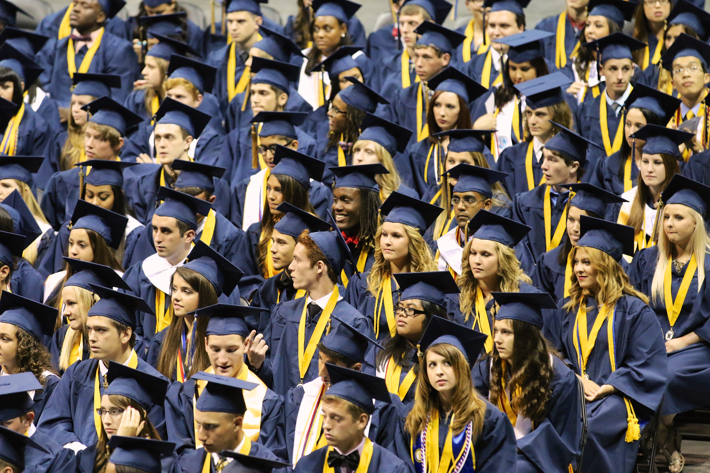
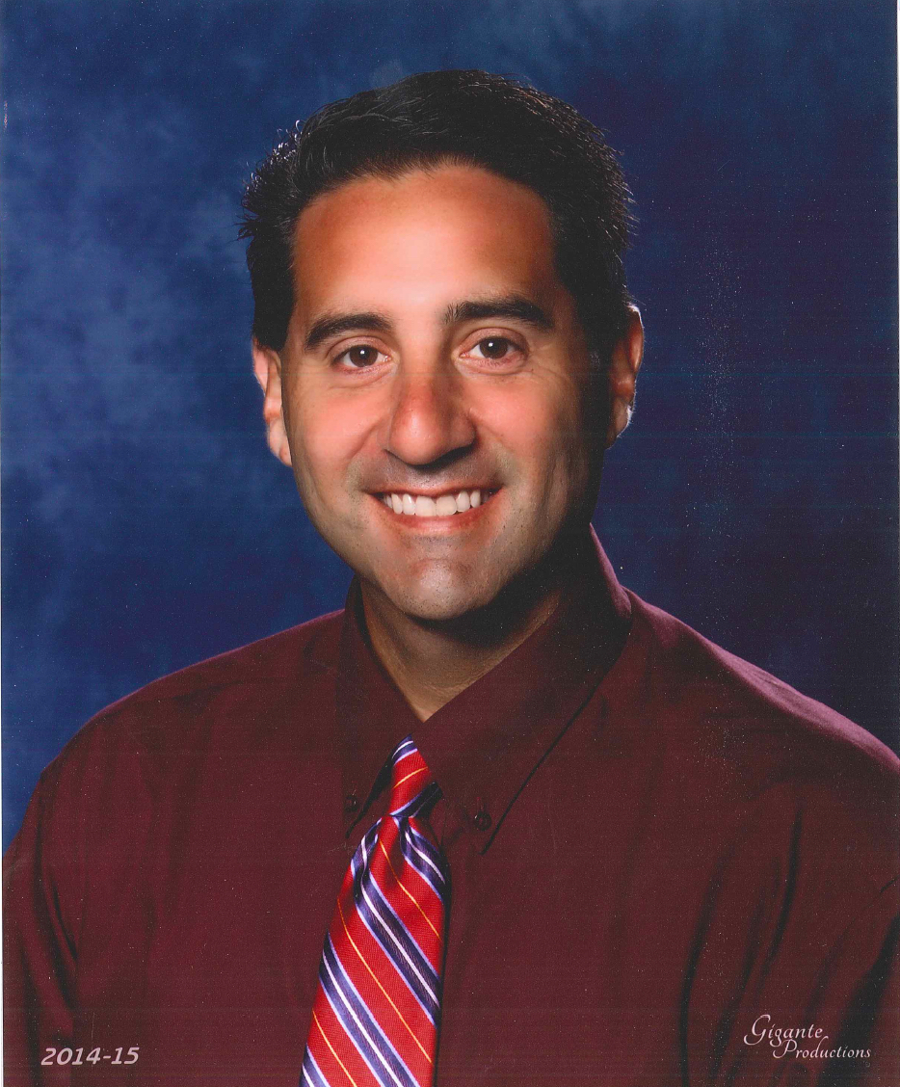
Class of 2022 9th Grade Course Selection
Administration
Mr. Mellin- Principal
Mr. Rich Batchelor- Assistant Principal
School Support
Ms. Wilson-School Counselor
Ms. Campbell- Graduation Coach
Ms. Colon- Career Specialist

Slide 2
Today’s Purpose
Know:
Course Requirements, Elective Requirements, and Academy and Elective Opportunities
Understand:
Gain a foundational understanding of credit and GPA requirements
Do
Understand and predict 3 Core Classes
Choose 2 required elective courses
Choose 1 choice elective class

Slide 3
Notes:
Give examples

Slide 4
English Pathways 4 Credits course
8th Language Arts ELA level 1,2 or 3
9th English 1
8th Language Arts Adv ELA level 4 or 5
10th English II
11th English III
12th English IV
9th English 1 Honors
10th English II Honors
11th English III Honors
12th English IV Honors
English 1 Honors
English II Honors
AP Language or Dual Enrollment 1101/1102
AP Literature or Dual Enrollment elective
8th Language Arts Adv ELA level 3, 4 or 5

Slide 5
Math Pathways 4 Required
10th Algebra II Honors
11th Pre-Calculus or Statistics
8th Geometry Honors
10th Pre-Calculus
12th AP Statistics or AP Calculus
10th Liberal Arts I
11th Geometry
12th Math for College Readiness
9th Geometry Honors
9th Algebra II Honors
11th AP Statistics or AP Calculus
8th Mathematics- level 4 or 5 on FSA Math
9th Algebra 1 Honors
10th Geometry Honors
11th Algebra II or Liberal Arts II
8th Algebra 1 Honors
12th Algebra II or Pre Calculus
12th Statistics or AP Calculus or AP Statistics
9th Algebra 1
8th Mathematics with level 1, 2 or 3 on FSA Math
Notes:
In Geo and making a C or lower recommending you take the class over again for grade replacement
1. You will be placed in Alg 1 Honors based on their scores so that you can be in a more rigorous course track

Slide 6
Science Pathways 3 Required
8th Grade Science FSA ELA 1 or 2
9th Biology
9th Environmental
10th Biology
8th Grade Science/Advanced Science FSA ELA 3
8th Grade Science/Advanced Science FSA ELA 3, 4 or 5 and A or B in current science
11^{th/}12th Marine or Physical or Anatomy and Physiology
10th Marine, Environmental
11^{th /}12th Marine or Physical or Anatomy and Physiology
9th Biology Honors
10th Physical Science Honors/Chemistry Honors
11th Any AP, Dual Enrollment or Honors course

Slide 7
Social Studies Pathways 3 Required
8th Grade US History
9th AP Human Geography
10th AP World History
11th AP US History
12th AP Government and AP Macro Economics
9th World History Honors
10th A.P. Human Geography (elective)
11th AP U.S. History
12th AP Government AP Macro Economics
8th Adv U.S History
9th No required course/World Cultural Geography (elective)
10th World History or World History Honors
11th US History or US History Honors
12th Econ/Gov or Econ/Gov Honors
8th Adv U.S History
Notes:
AP Human Geo- must be a level 3,4 or 5 on the FSA Reading. There is a summer Reading Requirement and 1 hr of H.W. a night
Emotional/Controvery
Level 1 or 2 No Social Studies
Level 3 in advanced

Slide 8
Required Electives
Physical Education
Online
HOPE (also meets online requirement)
Any course offered on Pasco or Florida Virtual
Fine or Performing Art
Band
Chorus
Art 2D
Acting
Digital Info Tech
Journalism 1
Notes:
Students will automatically be placed in a HOPE class their 9th grade year unless they have completed the course completely prior to the beginning of the 2018/19 school year. If you have not finished you will be taking HOPE on campus.

Slide 9
Choose Physical Education Requirement
During School Day
Online
HOPE- currently meets online requirement.
Personal Fitness (Online) and
Team Sports
Recreation
Basketball
Personal Fitness and additional Pasco eSchool PE course (Outdoor Education or Fitness Lifestyle Design) prior to 2018/19 school year
*All students must complete HOPE/or equivalent prior to the 2018/19 school year if selecting this option

Slide 10
Courses that meet fine art requirement
Fine Art
Fine Art Equivalent
Art 2D
Band
Chorus
Acting 1
Digital Information Technology (meets online requirement)
Journalism 1
Notes:
We will go into detail about each elective

Slide 11
Art
9th Grade
Art 2D 2
Portfolio 1,2 and 3
AP 2D Design or AP Drawing
Art 2D 1
10th Grade
11th/12th Grade

Slide 12
Band After school time component
Notes:
Intense after school commitment and it is a percentage of grade.

Slide 13
Chorus

Slide 14
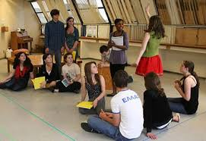
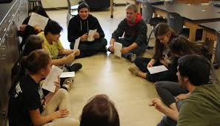
Acting

Slide 15
Journalism
Notes:
NEW PICTURE Writing Articles, Newspaper, Yearbook

Slide 16
digital information Technology
A path to your success
in school and work
Fine Arts Credit
Online Credit

Slide 17
Course Selection Checking Point
Students should have selected each of the following
1 English class
1 Mathematics class
1 Science class
1 Fine Art
1 HOPE
_________________________
Total 5 classes

Slide 18
Students have one choice elective
Academic
World Languages
Social Studies
Academy
Culinary
Agriculture
Technical Design
Digital Information Technology
Program
Language Arts
Early Childhood

Slide 19
Academic Electives
World Languages
Spanish
French
Social Studies
World History Honors*
AP Human Geography
Journalism
Creative Writing
Language Arts
American Sign Language
Notes:
*Meets Social Studies course requirement
**

Slide 20
Academy
Culinary
Culinary 1
Culinary 2
Agritechnology
Agriscience Foundations
Biotech 2
Early Childhood 2
Early Childhood 1
Early Childhood
Culinary 4
Biotech 3
Culinary 3
Animal Biotech
Early Childhood 3
Early Childhood 4

Slide 21
Applications are now open! www. http://lolhs.pasco.k12.fl.us

Slide 22
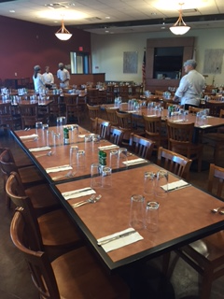
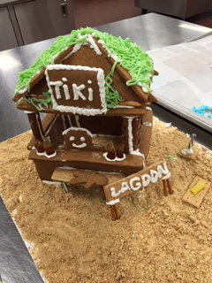
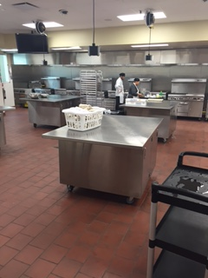
Culinary

Slide 23
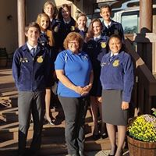
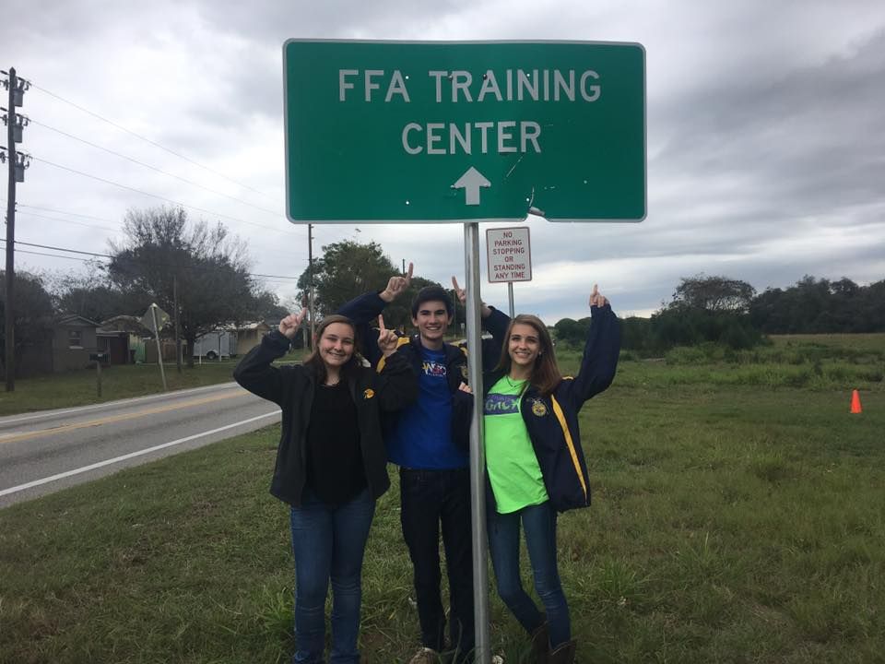
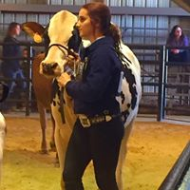
Agriculture

Slide 24
Early Childhood

Slide 25
Program
Digital Design
Digital Information Tech
Digital Design 1
Technical Design Drafting
Technical Design 1
Digital Design 3
Technical Design 2
Digital Design 2
Technical Design 3

Slide 26
Digital Information Technology
Foundational Course for technical courses
Canvas
Office 365 and use of district email and cloud space

Slide 27
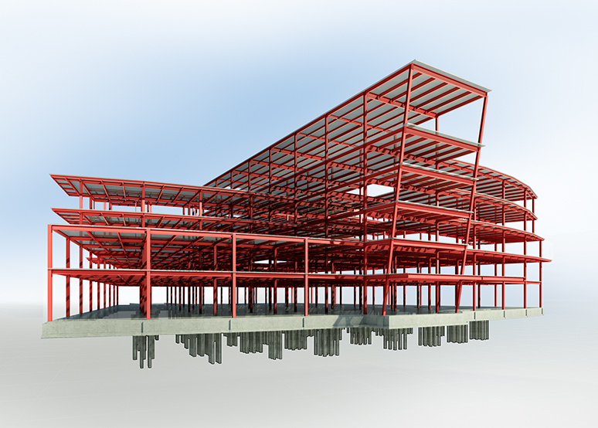
Technical Design 1
A three course program leading to industry certification
CAD, or computer-aided design and drafting (CADD), is the use of computer technology for design and design documentation. CAD software replaces manual drafting with an automated process.
TECHNICAL DESIGN I SERVES AS AN INTRODUCTION TO THE BASIC CONCEPTS OF ENGINEERING AND ARCHITECTURAL DESIGN AND
NAVIGATING THE CAD, COMPUTER AIDED DRAWING PLATFORM.

Slide 28
Choose 3 backup electives and number 1,2 and 3
Academic
World Languages
Social Studies
Academy
Culinary
Agriculture
Technical Design
Digital Information Technology
Program
Language Arts
Early Childhood
Notes:
Make three additional selections numbered by preference.

Slide 29
Final Check
Your student should have selected
1 English class
1 Mathematics class
1 Science class
1 HOPE
1 Fine Art
1 Additional Elective
_________________________
Total 6 classes
*Made 3 backup choices
*Prioritized 1-3
Notes:
Emphasis

Slide 30
Contact Information
Best way to contact for questions is through email
Mrs. Wilson: Knwilson@pasco.k12.fl.us
Ms. Campbell: Acampbel@pasco.k12.fl.us
Mr. Batchelor: Rbatchel@pasco.k12.fl.us

